Slide 1

SEARCHING AND SORTING

Slide 2
SEARCHING
Linear search Binary Search

Slide 3
LINEAR SEARCH:
It is a basic and a simple search algorithm for finding out an element present in given array.
It sequentially checks each element of the list until a match is found or whole list has been searched.
Best case of performance:0(1)
Worst case of performance:0(n)

Slide 4
Linear search code:
#include <stdio.h>
void main()
{ int a[5]={10,20,30,40,50};
int key,flag=0;
printf(“Enter search key”);
scanf(“%d”,&key);
for(int i=0;i<5;i++)
{ if(key==a[i]) #Checking
{ flag=1;
break; } }
If(flag==1)
printf(“Key is found”);
else
Printf(“Key not found”);
}

Slide 5
BINARY SEARCH:
Binary search is a search algorithm that finds the position of a target value within a array.
It compares target value with middle element of array.
Best case performance:0(1)
Worst case of performance:0(logn)

Slide 6
Binary search code:
#include <stdio.h>
void main()
{ int a[5]={10,20,30,40,50};
int key=50,flag=0;
int low=0,high=4;
while(low<high)
{ int mid=(low+high)/2; #Initialising Mid
if(key==a[mid])
{ flag=1;
break; }
else if(key<a[mid])
high=mid-1;
else
low=mid+1;
}
if(flag==1)
printf(“Key found”);
else
printf(“Key not found”); }

Slide 7
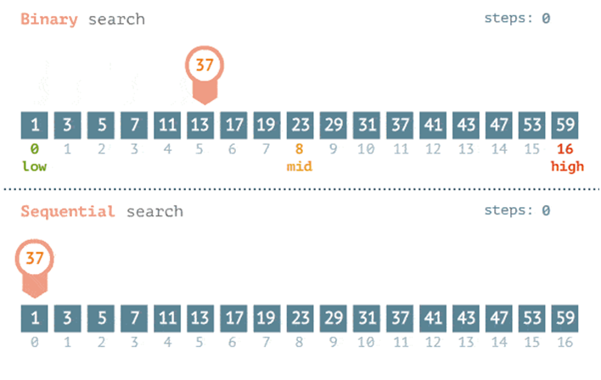
DIFFERENCES

Slide 8
DIFFERENCES
It takes more time for linear search or sequential search when compared to binary search when a bigger size array present.
Input data need to be sorted in binary search.
Linear search approaches sequential approach, but binary search implements divide and conquer approach.

Slide 9
SORTING
Bubble sort Insertion sort selection sort merge sort

Slide 10
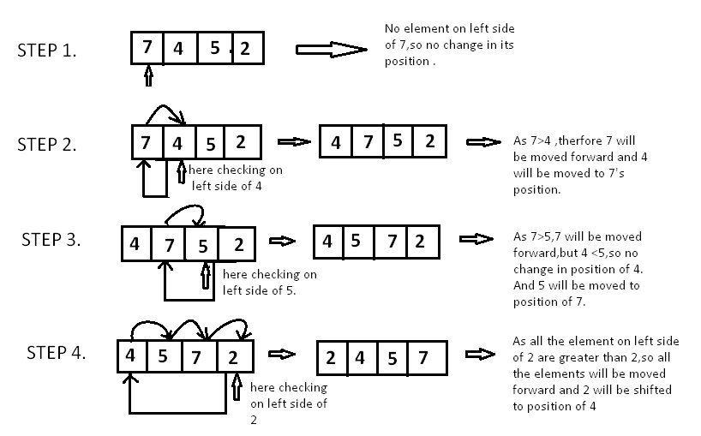
Insertion sort:

Slide 11
Code:
#include<stdio.h>
void main()
{ int n,a[20],temp;
printf(“Enter size of array”);
scanf(“%d”,&n);
printf(“Enter elements”);
for(int i=0;i<n;i++)
scanf(“%d”,&a[i]);
for(int i=1;i<n;i++) #Starting with second element
{ temp=a[i];
for(int j=i; j=0 && temp<a[j-1];j--) #Checking all previous elements
{ a[j]=a[j-1]; } #Insertion of previous element
a[j]=temp; }
for(int i=0;i<n;i++) #printing sorted array
printf(“%d”,a[i]);
}

Slide 12
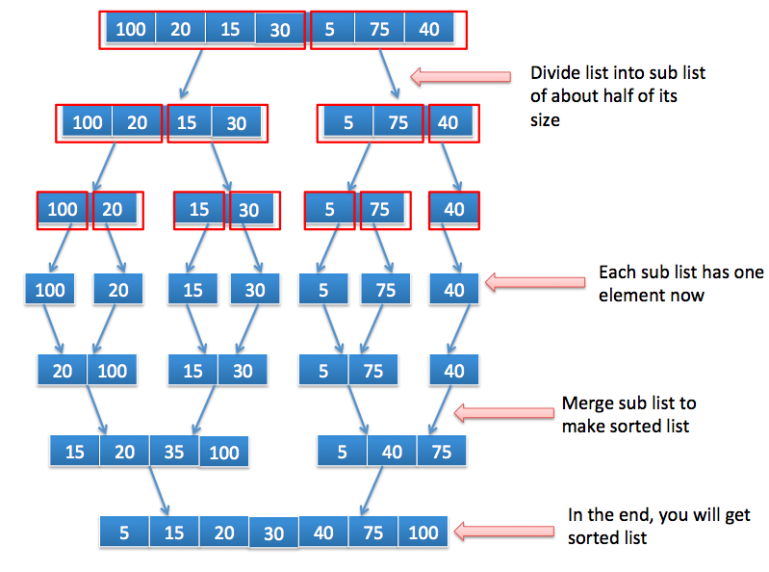
Merge sort:

Slide 13
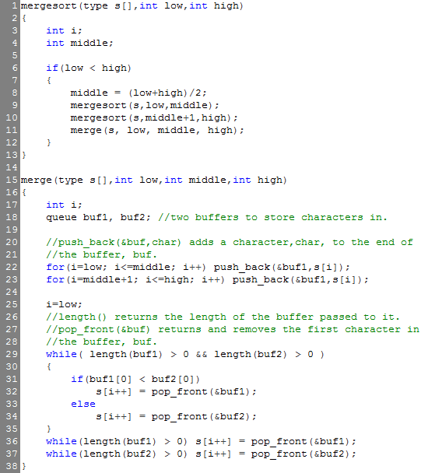
Merge sorting:

Slide 14
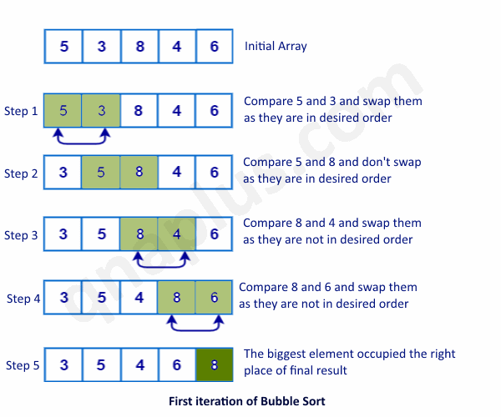
Bubble sort:

Slide 15
Code:
#include<stdio.h>
void main()
{ int a[10];
int n,temp;
printf(“Enter no. of elements”);
scanf(“%d”,&n);
printf(“Enter elements”);
for(int i=0;i<n;i++)
scanf(“%d”,&a[i]);
for(int i=0;i<n;i++) #No. of passes
{ for(int j=0;j<n;j++) #No. of comparison
{ if(a[j]>a[j++])
{ temp=a[j]; #Swapping
a[j]=a[j+1];
a[j+1]=temp;
} } }
for(int i=0;i<n;i++) #Printing sorted array
{ printf(“%d”,a[i] );}
}

Slide 16
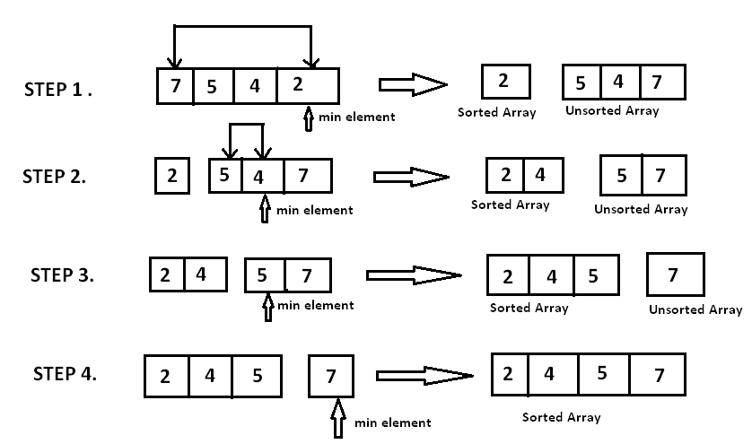
Selection sort:

Slide 17
Code:
#include<stdio.h>
void main()
{ int a[10],temp,min,n;
printf(”Enter no. of elements”);
scanf(“%d”,&n);
printf(“Enter elements”);
for(int i=0;i<n;i++)
scanf(“%d”,&a[i]);
for(int i=0;i<n;i++)
{ min=i; #Taking minimum (first element)
for(j=i+1;j<n;j++)
{ if(a[j]<a[min]) #Checking the lowest value
min=j;}
temp=a[i]; #Swapping
a[i]=a[min];
a[min]=temp;}
for(int i=0;i<n;i++) #Printing Sorted array
printf(“%d”,a[i]); }

Slide 18


